Slide 1
Discrete & Continuous Random Variables (Probability distributions, PMF, PDF, CDF, JPDF,JPMF)
Instructor
Osama Bin Ajaz
Lecturer, S & H Dept.,
FAST-NU, Main Campus, Karachi
osama.ajaz@nu.edu.pk

Slide 2
Continuous Probability Distributions
A continuous random variable has a probability of 0 of assuming exactly any of its values.
Because we are dealing with an interval rather than a point value of our random variable.
It does not matter whether we include an endpoint of the interval or not. For example:
Its probability distribution cannot be given in tabular form.
f(x) is usually called the probability density function.
Areas will be used to represent probabilities.

Slide 3
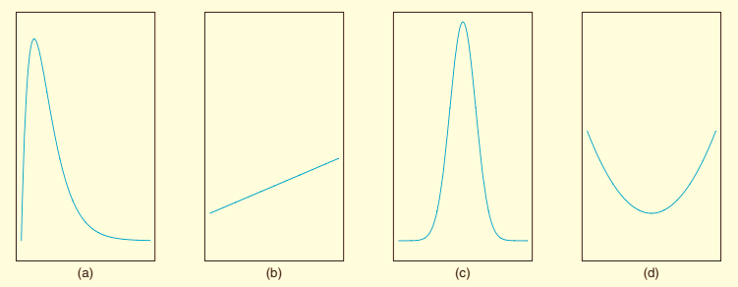
Some graphs of Density Functions
A probability density function is constructed so that the area under its curve bounded by the x axis is equal to 1 when computed over the range of X.

Slide 4
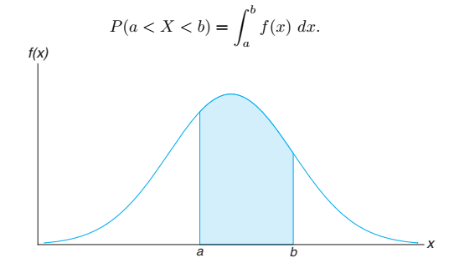
The probability that X assumes a value between a and b is equal to the shaded area

Slide 5
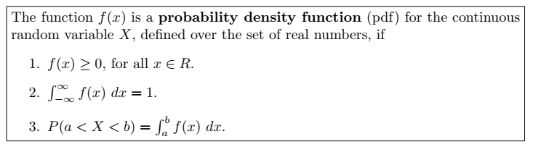
Function to be PDF

Slide 6
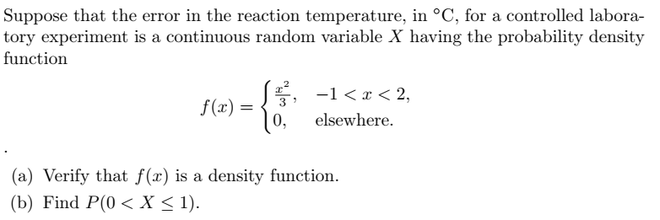
Example # 01

Slide 7
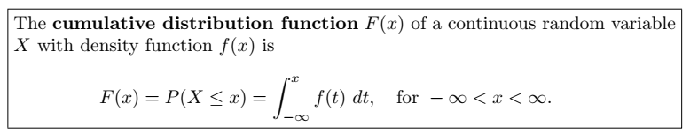

CDF for Continuous RV
As an immediate consequence of the above Definition, one can write the two results:

Slide 8
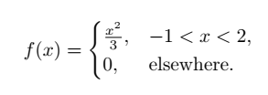
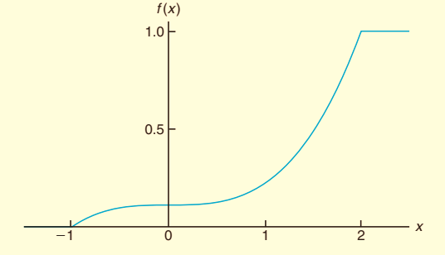
Example # 02
For the density function of previous example , find F(x), and use it to evaluate P(0 < X ≤ 1).
Notes:
P(0 < X < 1) = 1/9

Slide 9

Example # 03
The Department of Energy (DOE) puts projects out on bid and generally estimates what a reasonable bid should be. Call the estimate b. The DOE has determined that the density function of the winning (low) bid is:
Find F(y) and use it to determine the probability that the winning bid is less than the DOE’s preliminary estimate b.
Notes:
F(y) = 5y/8b - ¼ P(Y < b) = 3/8.

Slide 10
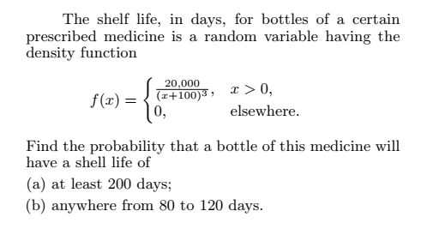
Example # 04
Notes:
(a) P(X > 200) = 1/9 (b) P (80 < x < 200) = 0.1020.

Slide 11
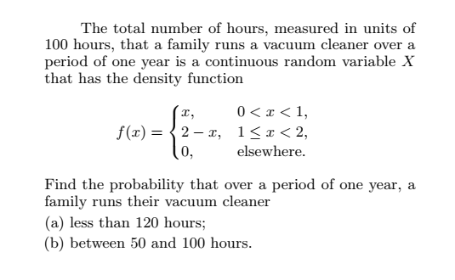
Example # 05
Notes:
(a) 0.68 (b) 0.375

Slide 12
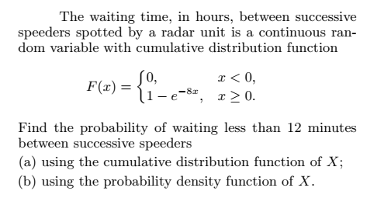
Example # 06
Notes:
(a) P(X < 0.2) = 0.7981 (b) f(x) = F’(x) =0.7981

Slide 13
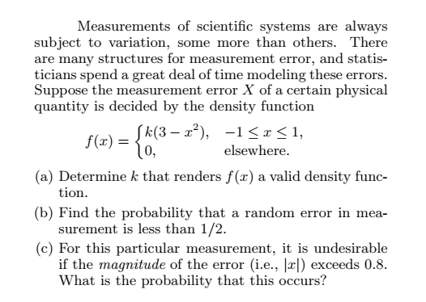
Example # 07
Notes:
(a) K = 3/16 (b) 0.7734 (c) 0.164

Slide 14
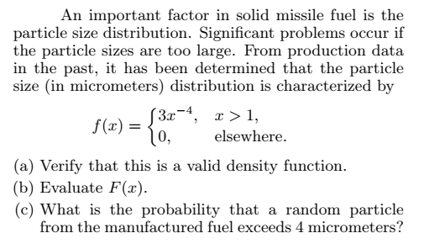
Example # 08
Notes:
(a) This is a pdf (b) F(x) = 1 – x^(-3) (c) 0.0156

Slide 15
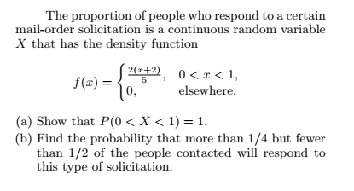
Example # 09
Notes:
1 (b) 19/80 = 0.2375

Slide 16
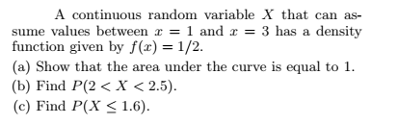
Example 10
Notes:
1 (b) ¼ (c)0.3

Slide 17
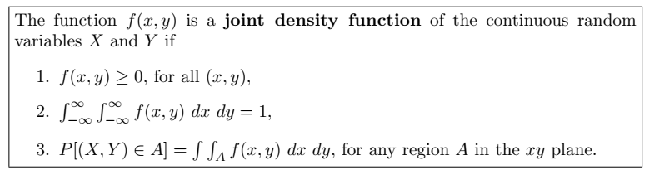
Joint Density Function for Continuous variable

Slide 18

Example # 09
A privately owned business operates both a drive-in facility and a walk-in facility. On a randomly selected day, let X and Y , respectively, be the proportions of the time that the drive-in and the walk-in facilities are in use, and suppose that the joint density function of these random variables is
(a) Verify for PDF? (b) Find P [(X, Y ) ∈ A], where A = {(x, y) | 0 < x < 1/2, 1/ 4 < y < 1/2}.
Notes:
(a) This is a pdf (b)

Slide 19
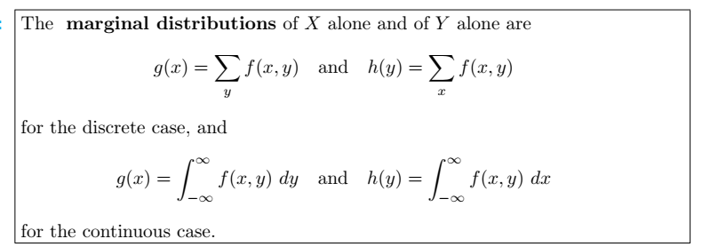
Marginal distribution for Continuous Variable

Slide 20
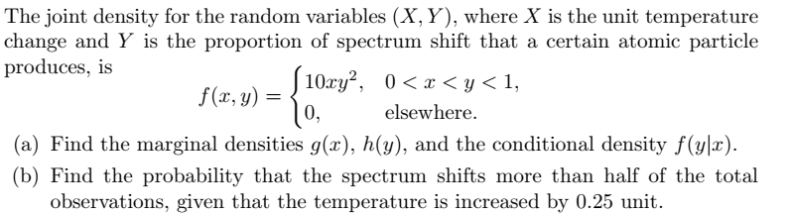
Example # 11
(c) Calculate: E(x), E(Y), E(xy)
take limit of x (0 to y) & limit of y ( 0 to 1) for verification of JPDF
Notes:
g(x) = (10/3)*x*(1-x^4) for 0 < x < 1 h(y) = 5y^4, for 0<y<1 (b) P(Y>0.5 | x = 0.25) = 8/9

Slide 21
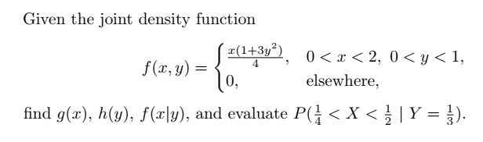
Example # 12
Notes:
G(x) = x/2 h(y) = (1+3y^2)/2 P(x|y=1/3) = 3/64 f(x|y) = x/2

Slide 22
Example # 10
Find g(x) and h(y) for the joint density function of previous Example?
Notes:
g(x) = (4x+3)/5 h(y) = 2(1+3y)/5

Slide 23
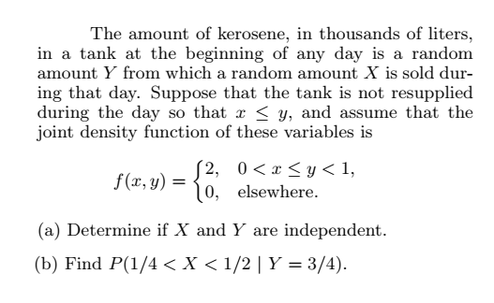
Example # 13
Notes:
No independent (b) 1/3

Slide 24
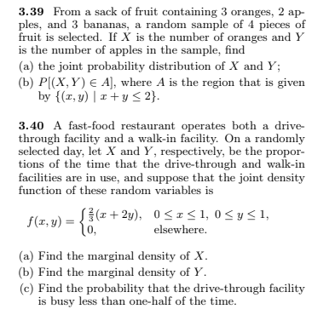

Slide 25
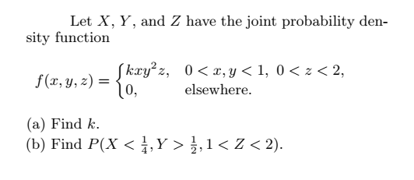
Example # 14
G(x,y), G(x,z), G(y,z), G(x), E(x) =?
Notes:
K = 3 (b) 21/512 = 0.04

Slide 26
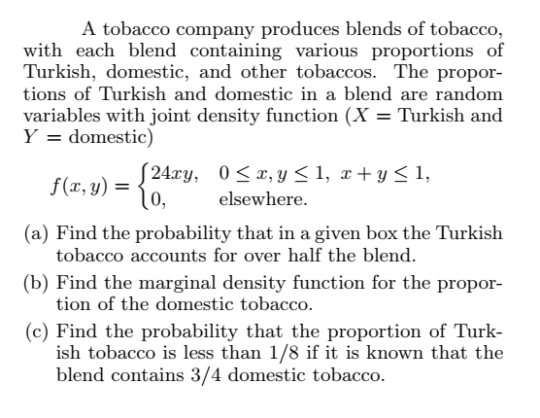
Example # 16
Notes:
0.3125
12y(1-y)^2
0.25

Slide 27
Example # 17
A salesperson for a medical device company has two appointments on a given day. At the first appointment, he believes that he has a 70% chance to make the deal, from which he can earn $1000 commission if successful. On the other hand, he thinks he only has a 40% chance to make the deal at the second appointment, from which, if successful, he can make $1500. What is his expected commission based on his own probability belief? Assume that the appointment results are independent of each other.
Notes:
$1300.

Slide 28
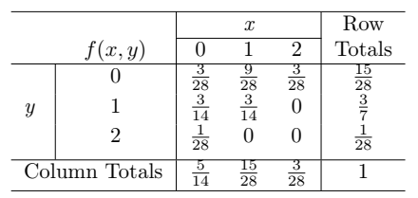
Example # 18
Let X and Y be the random variables with joint probability distribution indicated in Table below. Calculate E(XY).
Also calculate E(XY), E(x), E(y), V(x), V(y), Covariance (X, Y), correlation.
Notes:
E(XY) = 3/14

Slide 29
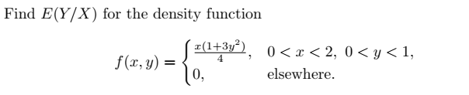
Example # 19
Also calculate E(XY), E(x), E(y), V(x), V(y), Covariance (X, Y), Correlation.
Notes:
E(y/x) = 5/8

